Slide 1


Self-check 1
Unit check 1
UNIT 1

Slide 2
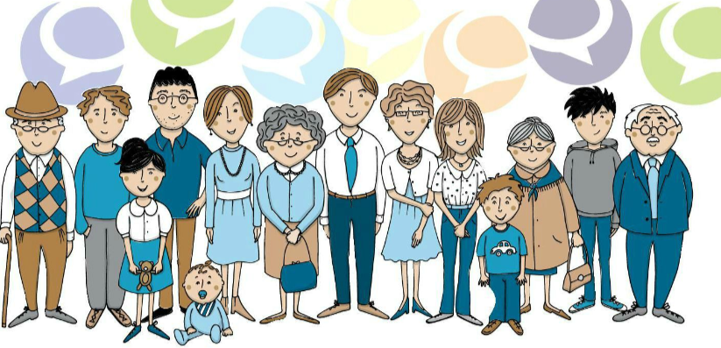
Revise the adjectives with this fun game
https://wordwall.net/play/843/528/554

Slide 3
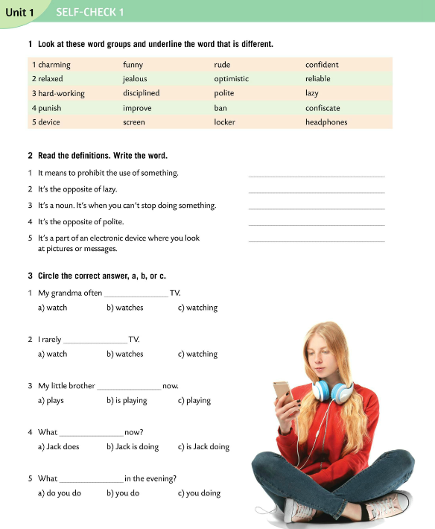
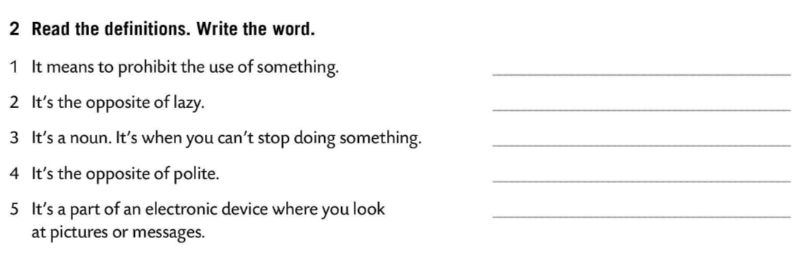
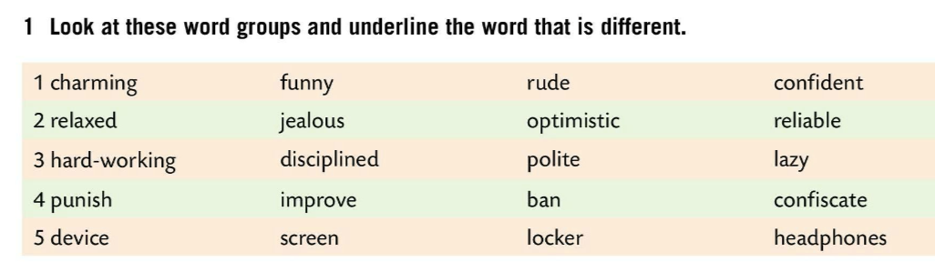
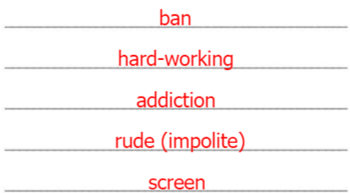
Look at these word groups and underline the word that is different.
Check.
Read the definitions. Write the words.
Check.

Slide 4
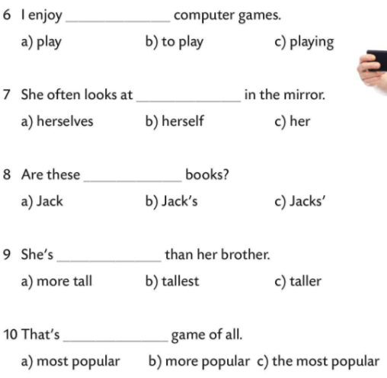
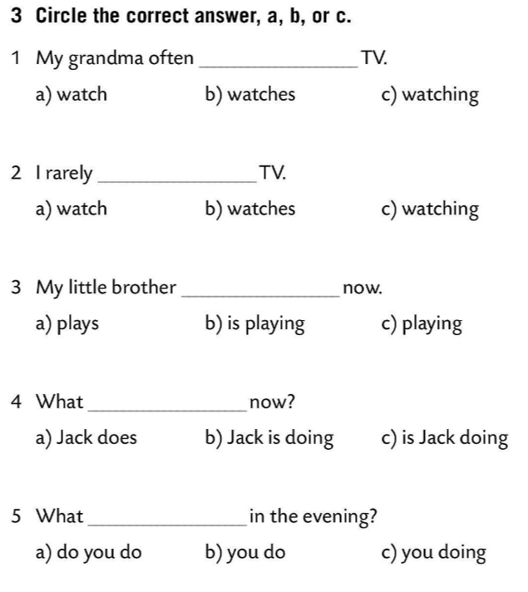

Circle the correct answer.
Check.

Slide 5
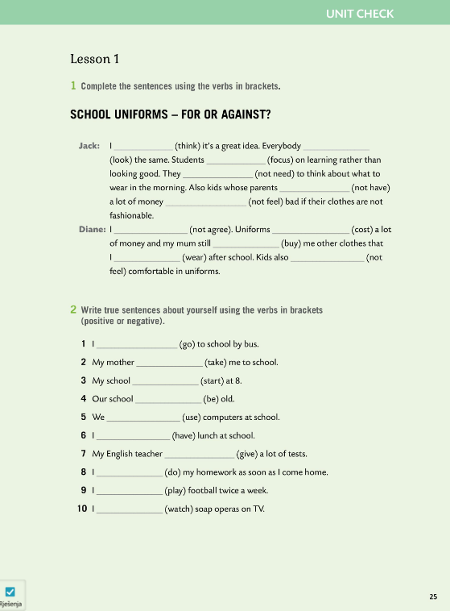

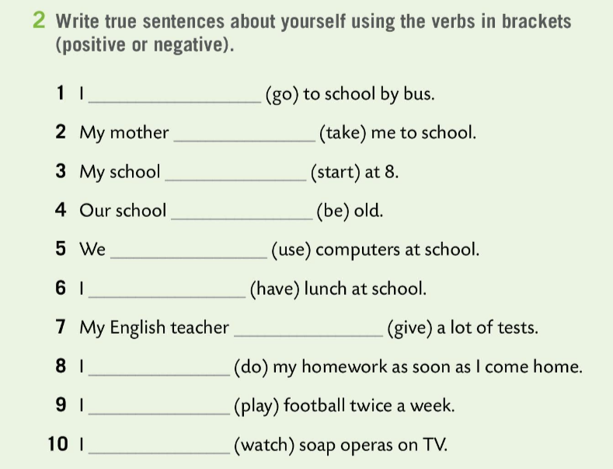
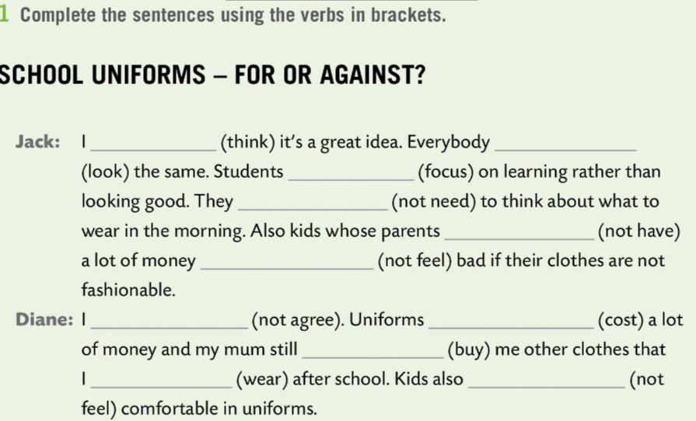
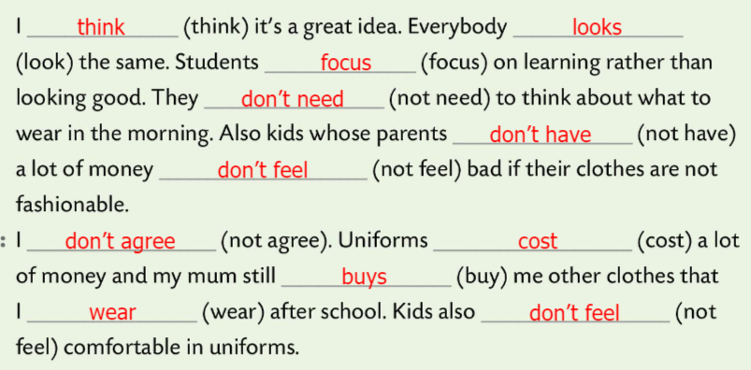
Workbook, page 25 UNIT CHECK
Complete the sentences using the verbs in brackets.
Check.
Write sentences about yourself using the verbs in brackets (positive or negative).
Check.

Slide 6
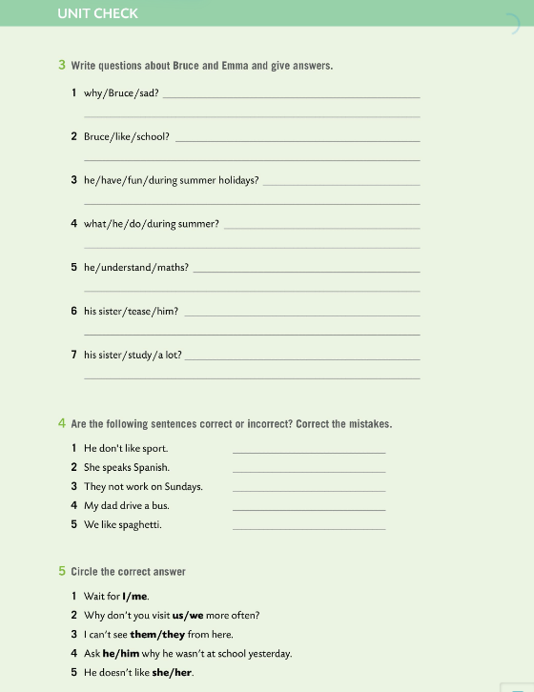
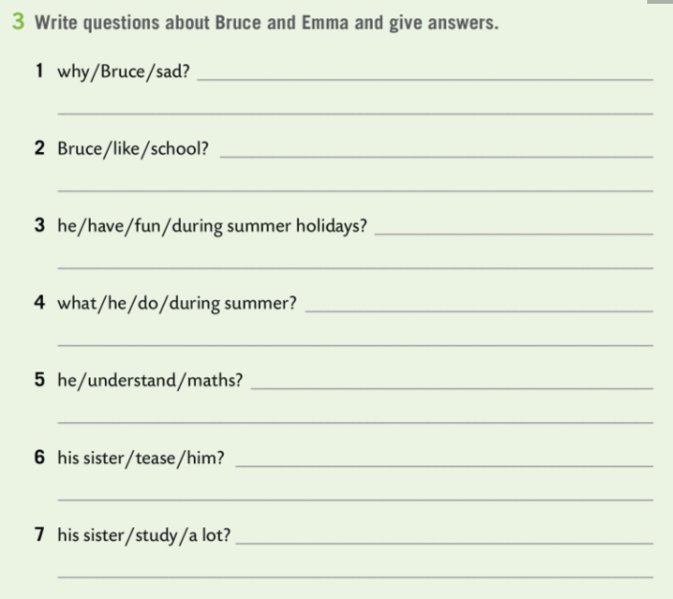
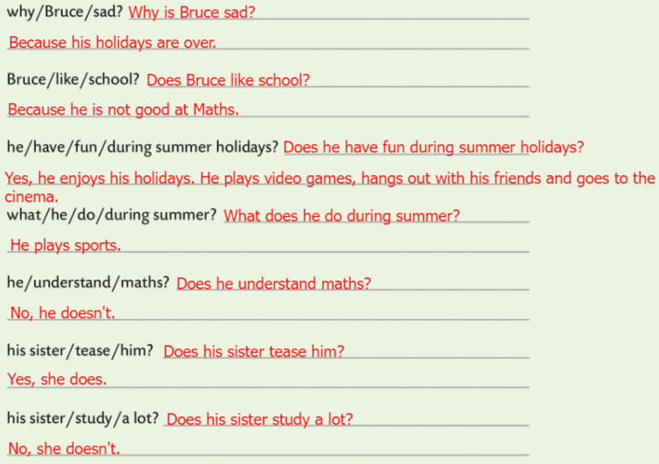
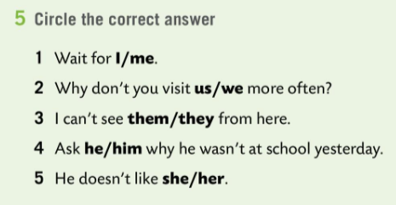
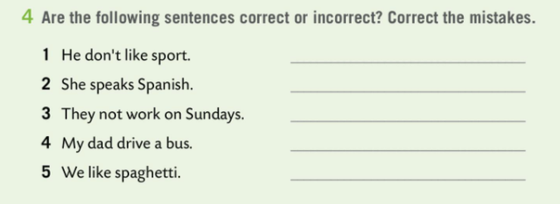
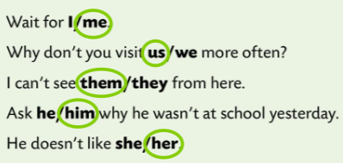
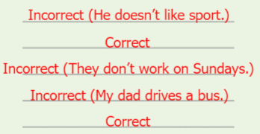
Workbook, page 26 UNIT CHECK
Write questions about Bruce and Emma and give answers.
Check.
Are the following sentences correct or incorrect? Correct the mistakes.
Check.
Circle the correct answer.
Check.

Slide 7
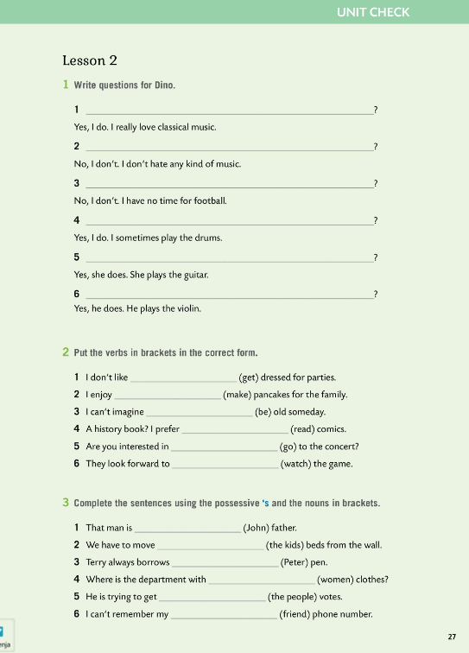
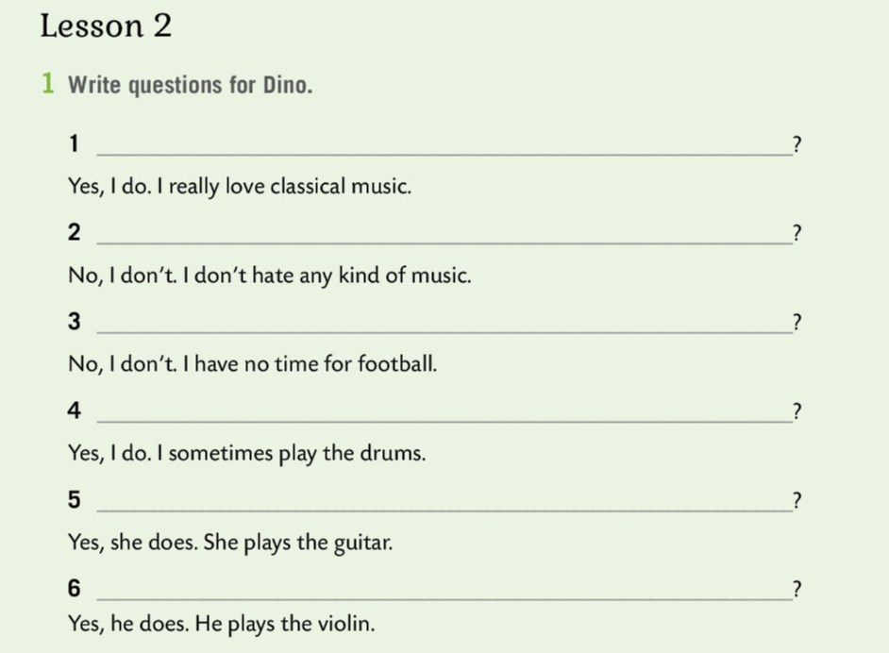
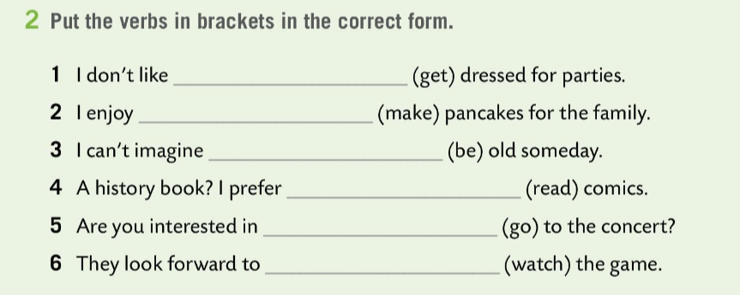
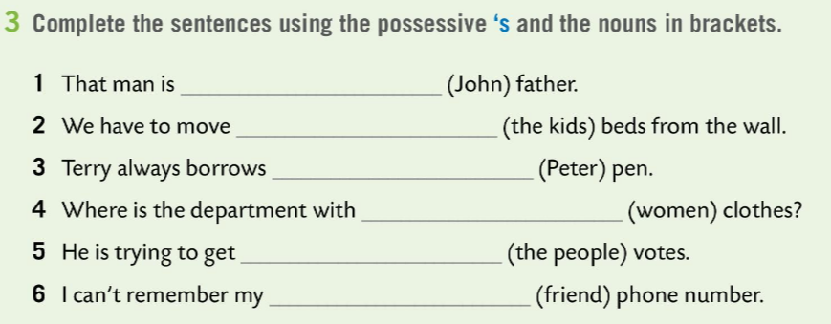
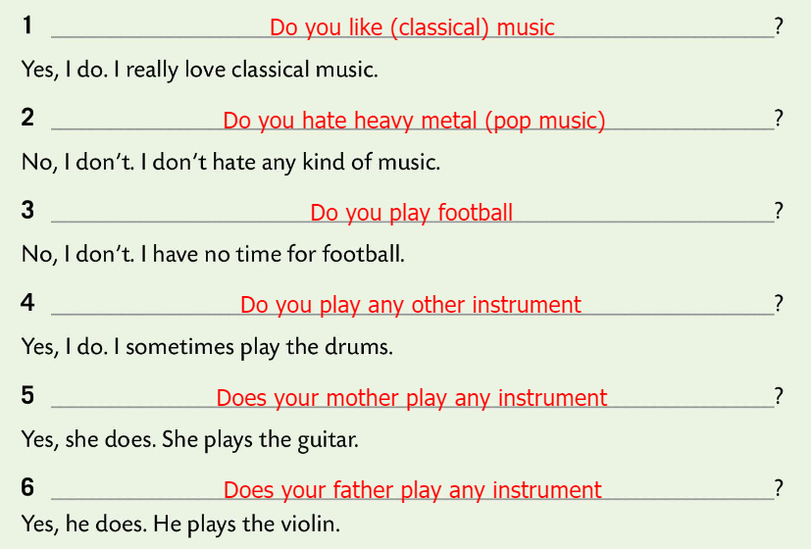
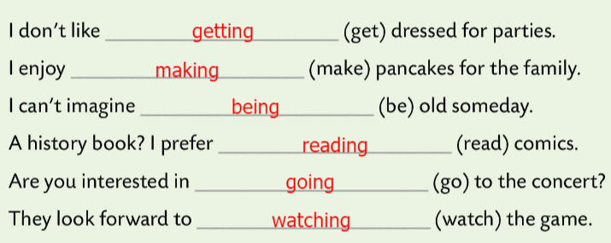
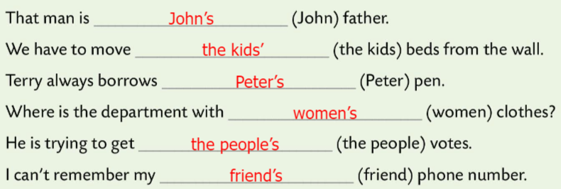
Workbook, page 27 UNIT CHECK
Write questions for Dino.
Check.
Put the verbs in brackets in the correct form.
Check.
Complete the sentences using the possessive ‘s and the nouns in brackets.
Check.

Slide 8
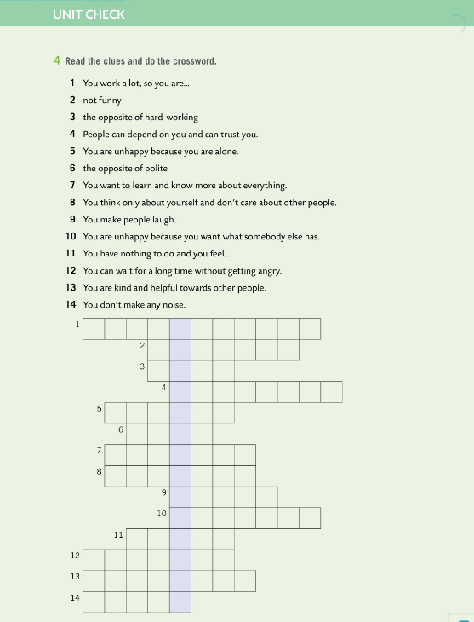
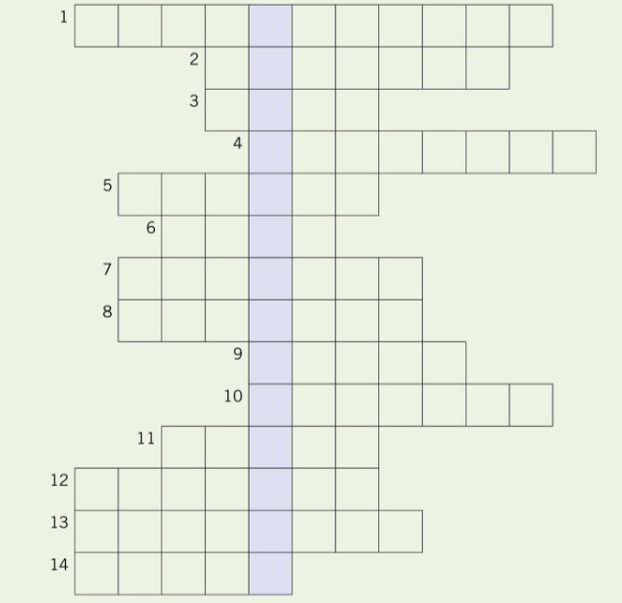
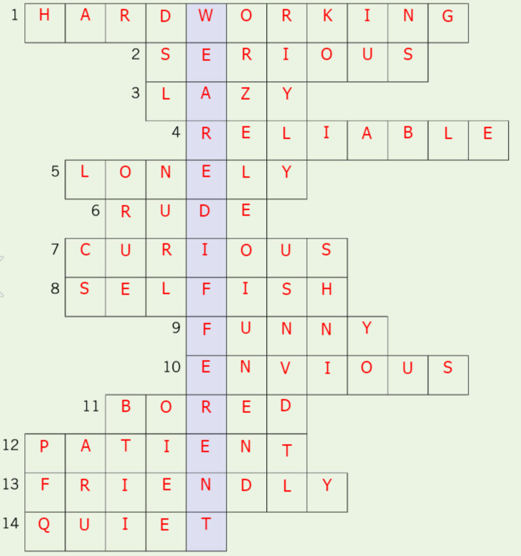
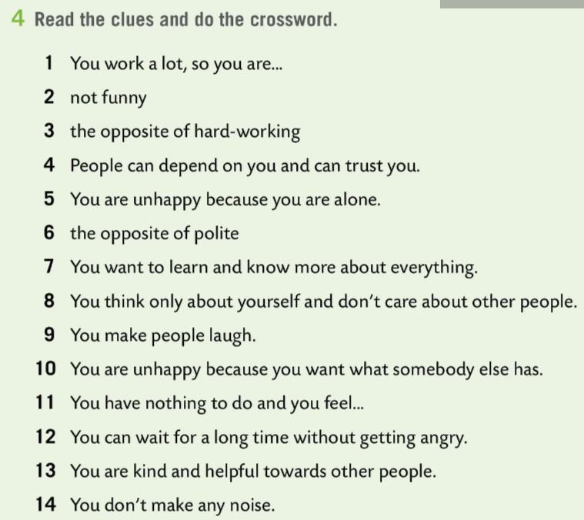
Workbook, page 28 UNIT CHECK
Read the clues and do the crossword.
Check.

Slide 9
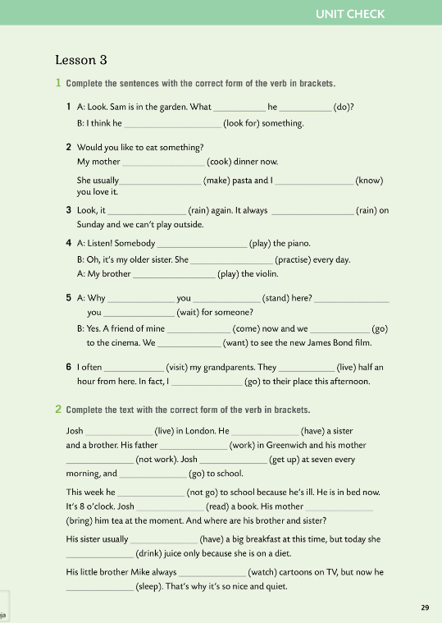
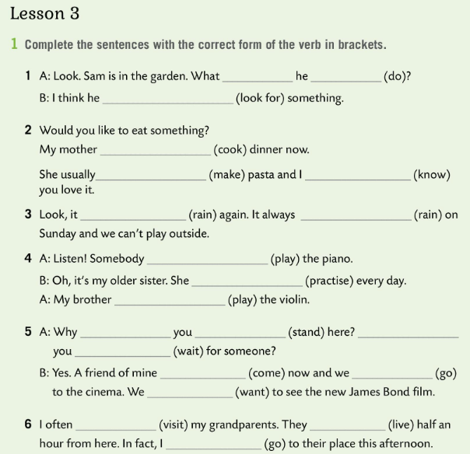
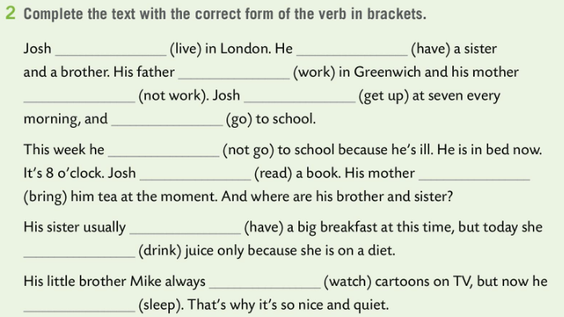
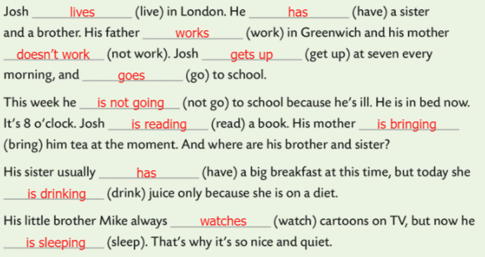
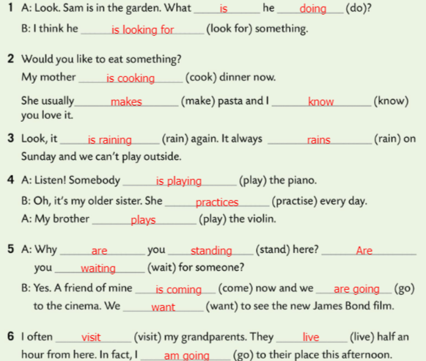
Workbook, page 29 UNIT CHECK
Complete the sentences with the correct from of the verb in brackets.
Check.
Complete the text with the correct form of the verbs in brackets.
Check.

Slide 10
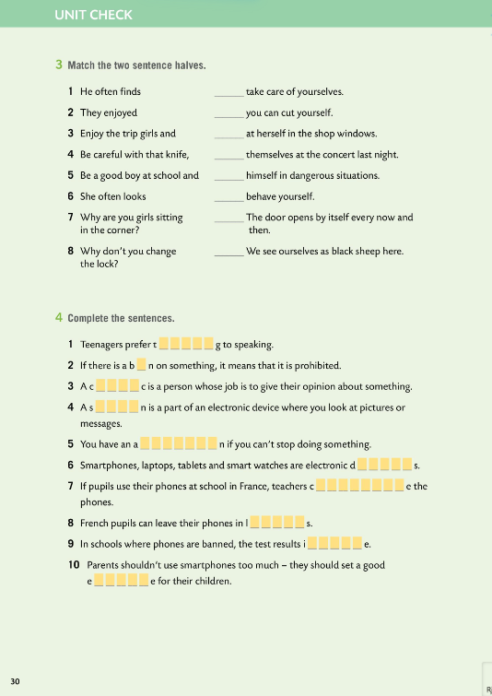
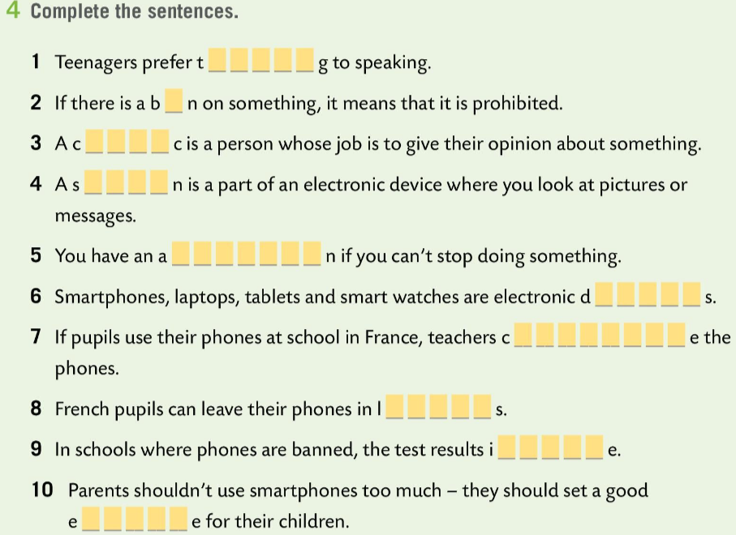
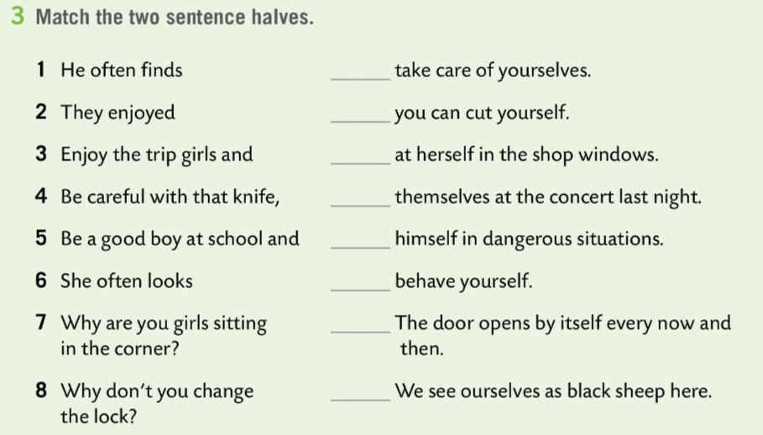
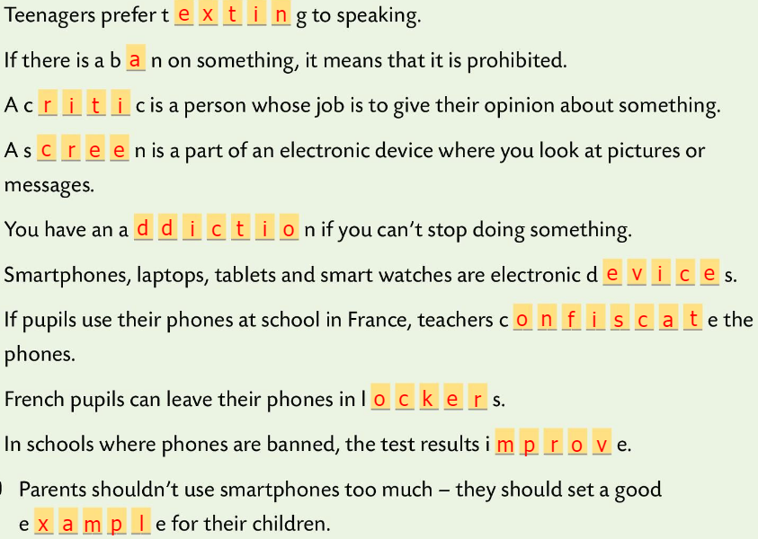

Workbook, page 30 UNIT CHECK
Match the two sentence halves.
Check.
Complete the sentences.
Check.

Slide 11
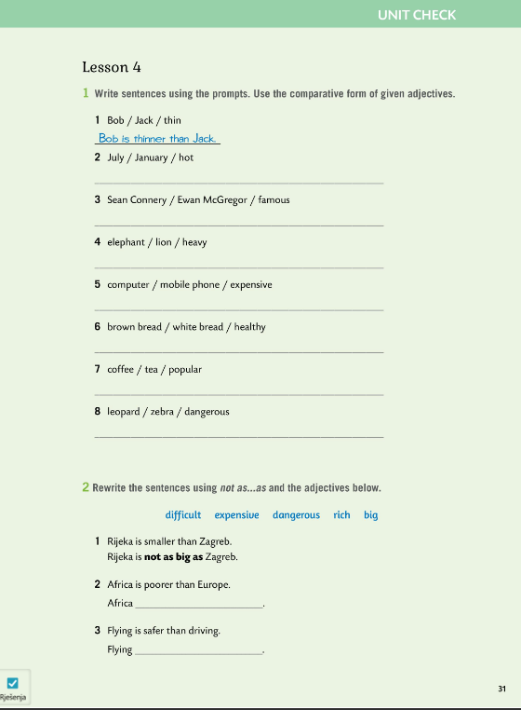
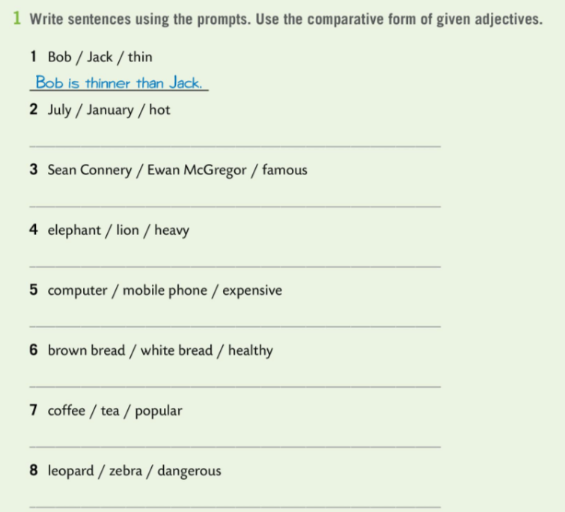
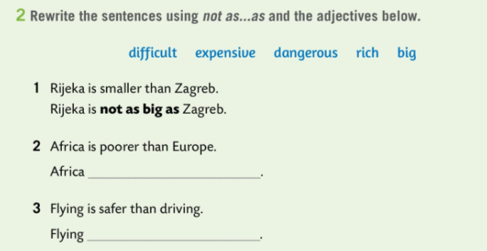
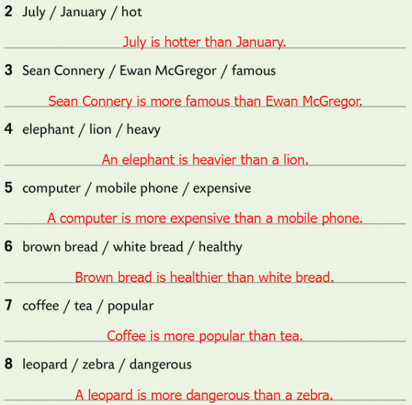
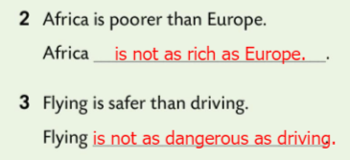
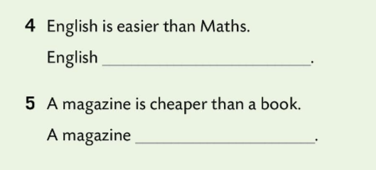
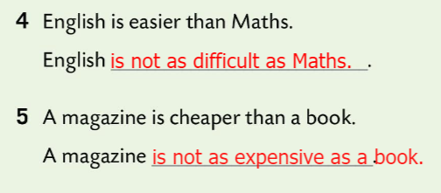
Workbook, page 31 UNIT CHECK
Write sentences using the prompts. Use comparative form of given adjectives.
Check.
Rewrite the sentences using not as…as and the adjectives below.
Check.

Slide 12
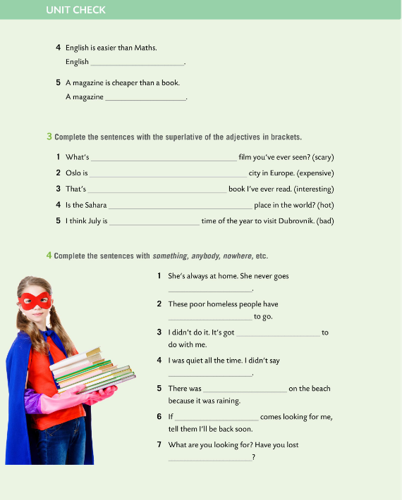
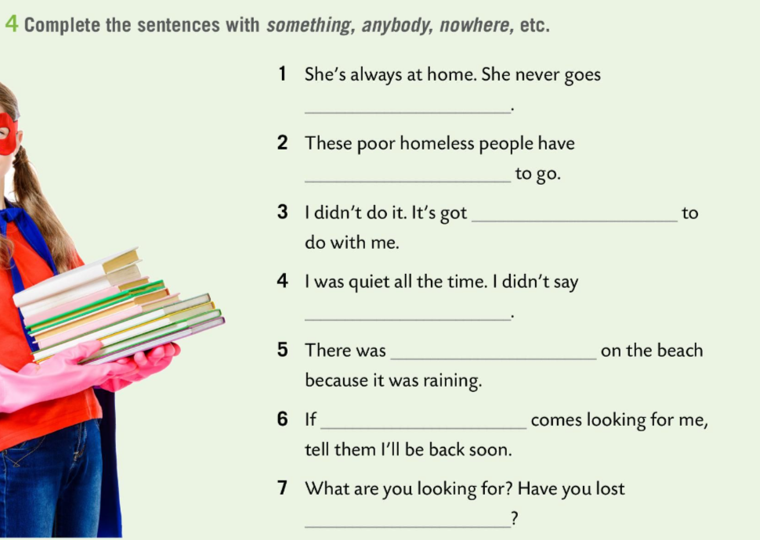
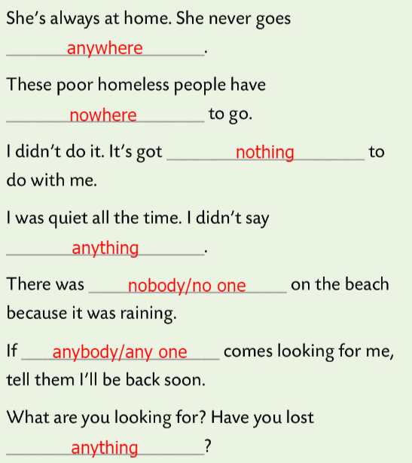
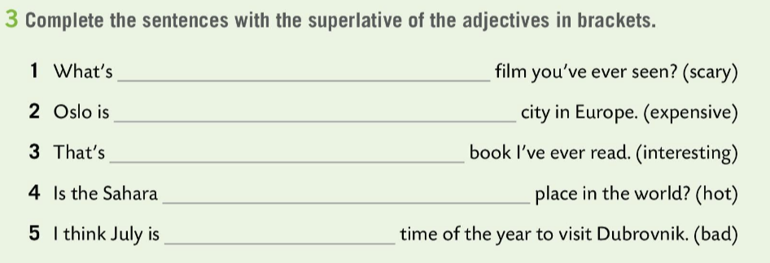
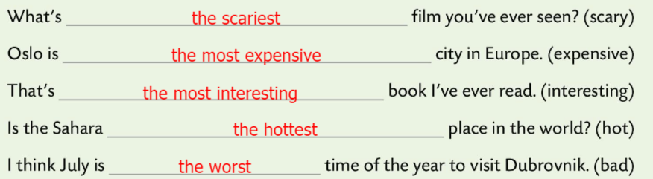
Workbook, page 32 UNIT CHECK
Complete the sentences with the superlative of the adjectives in brackets.
Check.
Complete the sentences with something, anybody, nowhere, etc.
Check.

Slide 13


Workbook, page 33 UNIT CHECK
Tick all the words/expressions you can translate. Look up the others in the word list.
Mark all the adjectives with a little star * and underline all the verbs.
Find words that can be used to describe someone’s character and choose three that are positive and three that are negative, in your opinion.
Write down the words/expressions you’d like to remember.

Slide 14



Workbook, page 34 UNIT CHECK
Tick the statements that are true for you.

Slide 15


Which outcomes did you master very well?
Which ones need more improvement and which need more time and practice?

